Slide 1
Intelligent Garbage Classification Using Deep Learning
TSP- AI ML Fundamentals (Capstone Project)
Presented By:
SASIDHAR S-au810021102701
Guided By: P. RAJA, AI Master Trainer

Slide 2
OUTLINE
Problem Statement
Proposed System/Solution
Algorithm & Deployment
GitHub Link
Project Demo(photos / videos)
Conclusion
Future Scope
References

Slide 3
Problem Statement
Effective waste management is a critical global challenge due to increasing waste production from urbanization, industrial activities, and population growth. Traditional waste sorting methods are often labor-intensive, time-consuming, and prone to human error, leading to improper disposal and reduced recycling efficiency. This mismanagement of waste contributes to environmental pollution, loss of recyclable materials, and overburdened landfills.The problem lies in the need for an automated, accurate, and scalable waste classification system that can reliably identify and sort different types of waste.

Slide 4
Proposed Solution
We propose an intelligent system that uses a Convolutional Neural Network (CNN) for image classification and deploys the model in a web application using Flask. Components:
1. Image Classification: Using a CNN to classify garbage items into predefined categories.
2. Web Application: Built with Flask to accept image uploads and return the predicted classification in real-time.
Objective:
To create a scalable, easy-to-use web application that allows users to upload garbage images and receive automated classification results

Slide 5
Algorithm & Deployment
Algorithm:
The system uses a CNN, which is a type of deep learning model commonly used for image classification tasks.
Steps in the Algorithm:
1.Image Preprocessing: Resize, normalize, and augment images.
2.Model Architecture: A multi-layer CNN to extract features from the images.
3.Training: Train the model using a labeled dataset of garbage images.
4.Inference: Classify new images based on learned features.
Deployment: The trained model is deployed as a Flask web application:
1.Flask Server: Handles image uploads and serves the trained model.
2.Frontend: Simple HTML interface for users to upload images.
3.Model Prediction: The Flask app sends the uploaded image to the model, which returns a classification label.
Deployment Tools:
Flask for the web application.
TensorFlow or Keras for model building.
Heroku or AWS for cloud deployment.

Slide 6
GitHub Link
https://github.com/Sasidhar810021102701/sasidhar-au810021102701

Slide 7
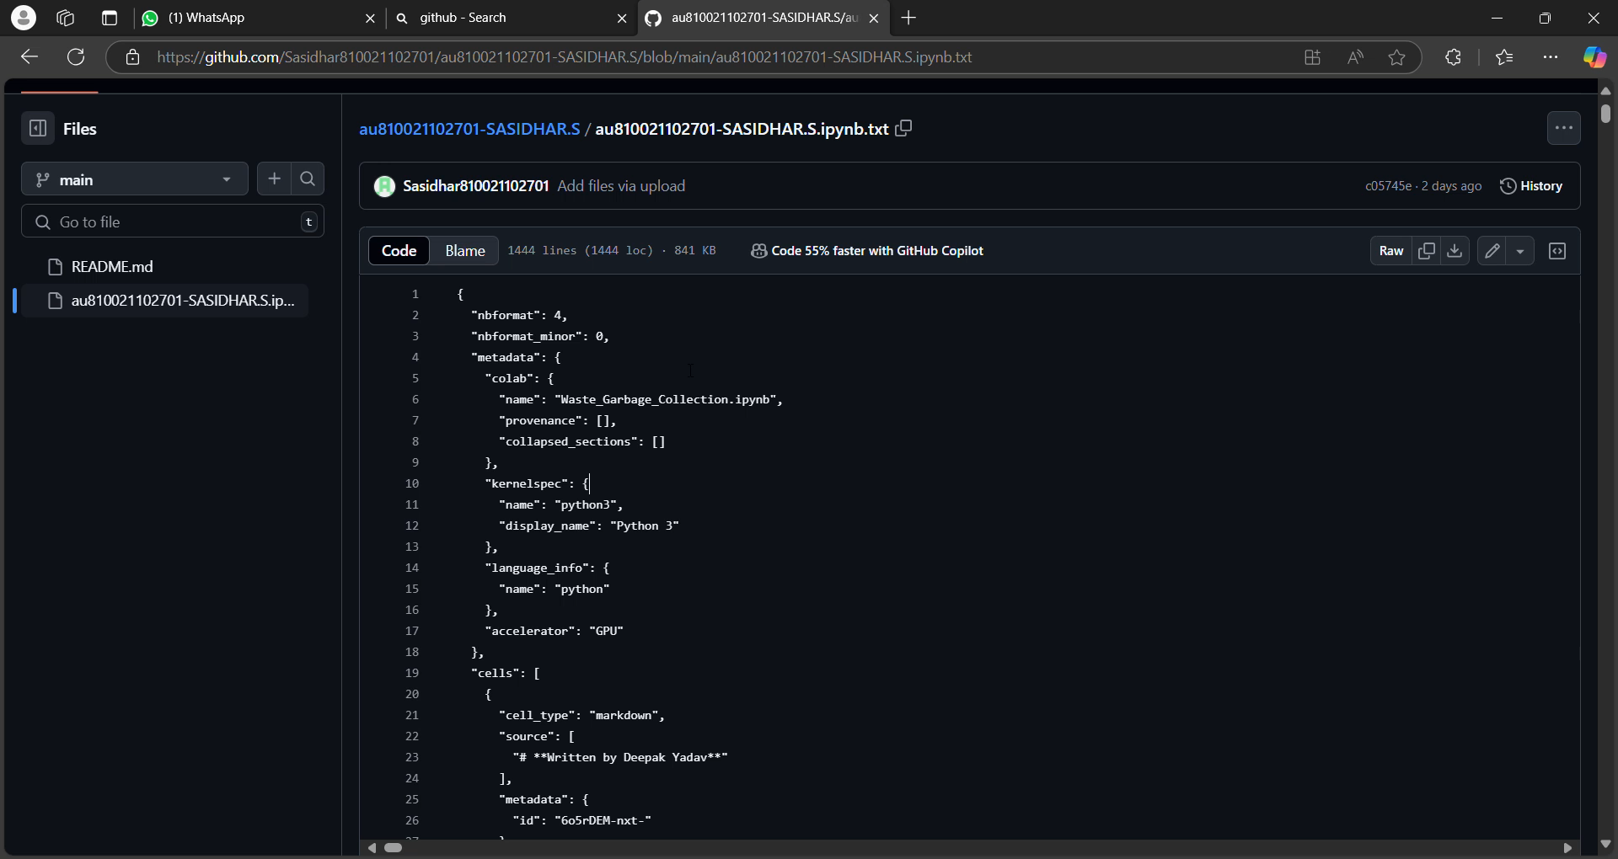
Project Demo(Recorded Video)

Slide 8
Conclusion
This project demonstrates how deep learning (CNN) can be applied to solve real-world problems like waste classification. By leveraging AI and deploying the model via a web application, we have created a user-friendly system for automatic waste sorting.
Key Achievements:
Built a CNN model for accurate garbage classification.
Successfully deployed the model as a web app using Flask.
Designed a simple and effective user interface for easy interaction.
Challenges:
Gathering and labeling a large dataset of garbage images.
Ensuring accurate predictions in real-world scenarios.

Slide 9
Future Scope
Improvement of Model: Expanding the dataset to include more garbage types (e.g., textiles, electronic waste). Improving model accuracy using more advanced architectures or transfer learning techniques (e.g., ResNet, VGG).
Scaling:
Deploying the application at scale on cloud platforms like AWS, Google Cloud, or Microsoft Azure.
Real-Time Applications:
Integration with smart trash bins for real-time waste classification in public places or homes.
Mobile App:
Development of a mobile app to allow users to classify garbage using their smartphone cameras.

Slide 10
References
Tensor Flow Documentation: https://www.tensorflow.org/
Flask Documentation: https://flask.palletsprojects.com/
O. Kuchaiev and B. Ginsburg, “Factorization tricks for LSTM networks,” 2016 IEEE Conf. Comput. Vis. Pattern Recognit., 2017, pp. 1-6.

Slide 11
THANK YOU

